Slide 1
Predicting Heart Attacks with Machine Learning Algorithms
V Karthick, Associate Professor
Department of CSE TEAM MEMBERS
Rajalakshmi Engineering College NANDHA KRISHNA -210701518
Chennai, India VISHAL -210701312
vkarthick86@gmail.com SRI PRASATH -210701261

Slide 2
ABSTRACT
The heart, a vital organ in humans, plays a crucial role in purifying and circulating blood throughout the body. Heart attacks, a leading cause of death worldwide, manifest through symptoms like chest pain, rapid heartbeat, and breathing difficulties. This study presents a comprehensive examination of heart attacks and contemporary prediction techniques. It provides an overview of different machine learning methodologies employed for heart attack prediction, including Decision Tree, Logistic Regression, Support Vector Machines (SVM), Naive Bayes, Random Forest, K-Nearest Neighbours (KNN), and XGBoost Classifier. The comparison of these algorithms is conducted based on their respective features, offering insights into their effectiveness. The purpose of this study is to support ongoing efforts to create precise and effective models of prediction for cardiac diagnosis and prevention.

Slide 3
INTRODUCTION
The heart, being a vital organ, demands meticulous care to ensure overall well-being. Given its association with various diseases, including heart attacks,
predictive studies in this domain are crucial. Currently, a significant number of individuals succumb to heart attacks, often diagnosed at advanced stages due to the lack of precise predictive tools.
Healthcare industries grapple with the challenge of early heart attack prediction owing to the complexity and variability of health data. Researchers endeavour to develop prototypes capable of early detection, encountering both benefits and limitations in their approaches. Machine learning systems, leveraging data processing and utilization, offer promising avenues for predictive analytics. By harnessing natural constraints like cholesterol levels, blood pressure, age, and gender, various algorithms such as Decision Trees, Random Forest, Naive Bayes, K-Nearest Neighbours, Support Vector Machines (SVM), and Logistic Regression, and XGBoost are compared for their predictive accuracy.

Slide 4
LITERATURE REVIEWS
PAPER | AUTHOR | RELEASE DATE | REVIEW
Comprehensive evaluation and performance analysis of machine learning in heart disease prediction | Al-Alshaikh, H. A., P, P., Poonia, R. C., Saudagar, A. K. J., Yadav, M., AlSagri, H. S., & AlSanad, A. A. (2024) | SEP,2024 | Heart disease is a leading cause of mortality on a global scale. Accurately predicting cardiovascular disease poses a significant challenge within clinical data analysis.
Revolutionizing heart disease prediction with quantum-enhanced machine learning | Babu, S. V., Ramya, P., & Gracewell, J. (2024) | JUN,2024 | The recent developments in quantum technology have opened up new opportunities for machine learning algorithms to assist the healthcare industry in diagnosing complex health disorders, such as heart disease.

Slide 5
LITERATURE REVIEWS
PAPER | AUTHOR | RELEASE DATE | REVIEW
Predicting Heart Attacks with Machine Learning Algorithms | Kumar, D. V. S., Chaurasia, R., Misra, A., Misra, P. K., & Khang, A. (2023). | AUG,2024 | In this paper, we have researched the prediction of heart illness and liver infection through the process of machine learning (ML) in the point of data analytics.
Effective Feature Engineering Technique for Heart Disease Prediction With Machine Learning | Babu, S. V., Ramya, P., & Gracewell, J. (2024) | JUN,2024 | The recent developments in quantum technology have opened up new opportunities for machine learning algorithms to assist the healthcare industry in diagnosing complex health disorders, such as heart disease.

Slide 6
LITERATURE REVIEWS
PAPER | AUTHOR | RELEASE DATE | REVIEW
A classification and regression tree algorithm for heart disease modeling and prediction | Ozcan, M., & Peker, S. (2023). | November 2023 | Heart disease remains the leading cause of death, such that nearly one-third of all deaths worldwide are estimated to be caused by heart-related conditions. Advancing applications of classification-based machine learning to medicine facilitates earlier detection.
Machine Learning and Deep Learning Techniques on Accurate Risk Prediction of Coronary Heart Disease | Shukur, B. S., & Mijwil, M. M. (2023). | February 2023 | Coronary artery disorder is the heart disease that is prevalent across the globe today. It's a serious issue for the humans as it requires proper diagnosis.

Slide 7
LITERATURE REVIEWS
PAPER | AUTHOR | RELEASE DATE | REVIEW
Heart Disease Prediction Using Machine Learning Algorithms with Self-Measurable Physical Condition Indicators | Bizimana, P. C., Zhang, Z., Asim, M., & Abd El-Latif, A. A. (2023). | February 2023 | the number of cases of heart disease has been greatly increasing, and heart disease is associated with a high mortality rate. Moreover, with the development of technologies
A cardiologist’s guide to machine learning in cardiovascular disease prognosis prediction | Kresoja, K. P., Unterhuber, M., Wachter, R., Thiele, H., & Lurz, P. (2023). | March 2023 | A modern-day physician is faced with a vast abundance of clinical and scientific data, by far surpassing the capabilities of the human mind. Until the last decade, advances in data availability have not been accompanied by analytical approaches.

Slide 8
LITERATURE REVIEWS
PAPER | AUTHOR | RELEASE DATE | REVIEW
A hybrid model for predicting heart disease using CNN and BiLSTM algorithms | Shrivastava, P. K., Sharma, M., & Kumar, A. (2023). | February 2023 | In human existence, healthcare is an inevitable obligation. Heart disease is a broad term that encompasses a variety of illnesses that affect the heart & veins.
Classification model for meticulous presaging of heart disease through NCA using machine learning | Aggarwal, R., & Kumar, S. (2023). | March 2023 | For the design and implementation of Clinical decision support system, computation time and prognostic accuracy are very important. To analyze the large collection of a dataset for detecting and diagnosis disease machine learning techniques are used.

Slide 9
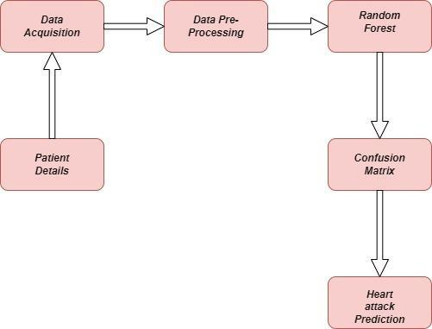
PROPOSED METHODOLOGY

Slide 10
CONCLUSION & FUTURE ENHANCEMENT
The prediction of heart attacks is a major difficulty in the modern world. By entering pertinent parameters from their medical reports, people can use these programs to predict the risk of a heart attack in situations where they do not have instant access to medical personnel. Equipped with this knowledge, individuals can decide whether to seek medical attention, potentially reducing the severity of the crisis.
Incorporate Advanced Machine Learning Algorithms Deep Learning Models: Utilize deep neural networks (DNNs), convolutional neural networks (CNNs), and recurrent neural networks (RNNs) to capture complex patterns in the data. Ensemble Methods: Implement ensemble techniques like Random Forest, Gradient Boosting Machines (GBM), and XGBoost to combine the predictions of multiple models for improved accuracy.

Slide 11
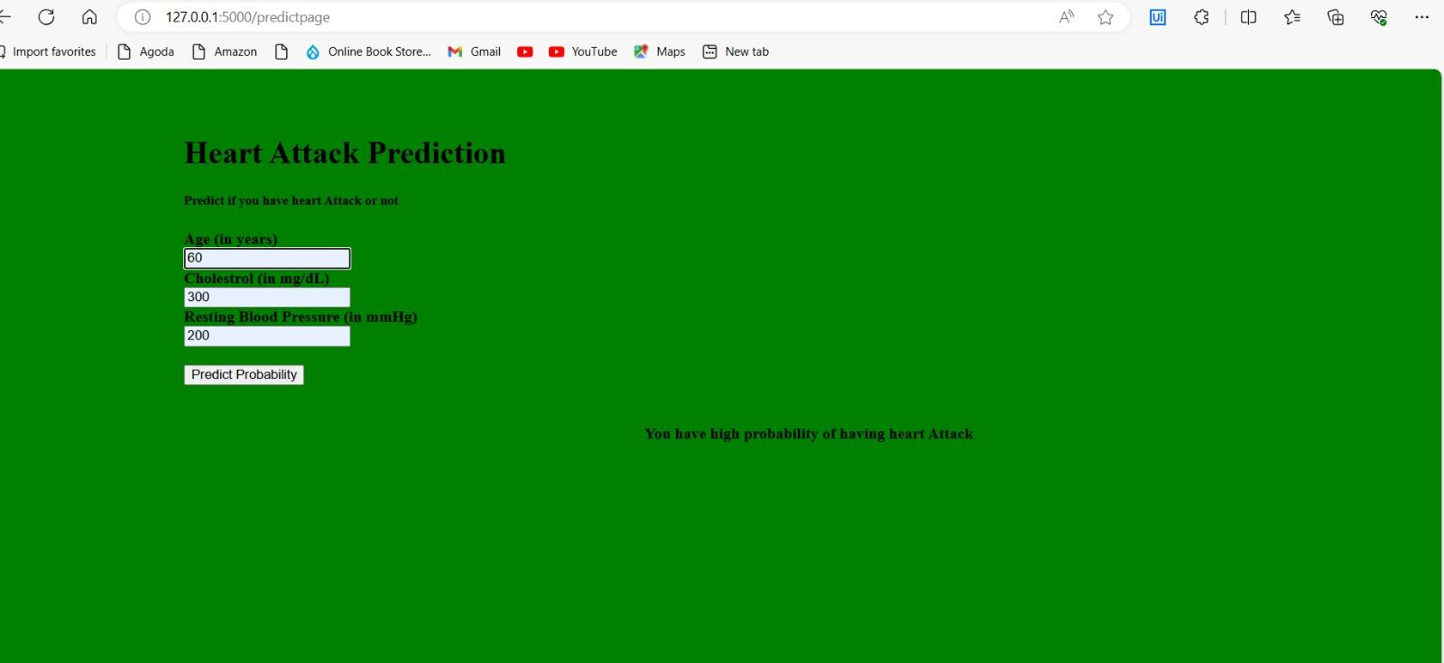
OUTPUT

Slide 12
REFERENCES
[1]Dilsizian, S. E., & Siegel - E.Machine Learning Algorithms for Predicting Heart Attack , June 2020
[2] Nazir .H - Hybrid Machine Learning for predicting heart attack,August 2020.
[3] Raghupathi.W, Deep Learning Models for Predicting Cardiovascular Risk,November 2020.
[4] Yadav .S - Machine Learning Models for Heart Disease Prediction,March 2021.
[5] Asri, H., Mousannif, H.,Moatassime, H., Noel, T. - Study comparing machine learning algorithms for predicting heart disease,May 2021.
[6] Ribeiro, M. - Case study on explainable AI techniques for interpreting machine learning models in heart disease prediction,August 2021.
[7] Madi, N. - Comprehensive survey on machine learning algorithms for heart disease prediction, including ensemble methods,September 2021.
[8] Sudhakar, K. - Paper investigating the use of genetic algorithms for feature selection in heart disease prediction,March 2022.
[9] Zhang, S. (2024). Enhancing heart disease prediction through ensemble learning and feature engineering: A comparative analysis,December 2023.

Slide 13
THANK YOU

